Slide 1
Restaurant Reviews NLP
Hernan Trujillo

Slide 2
01
Introduction

Slide 3
02
Data

Slide 4
Data Gathering
01
02
03
04
Source
Kaggle.com
https://www.kaggle.com/vigneshwarsofficial/reviews
Type of Data
Restaurant Reviews (text) & Likes (numbers)
Amount of Data
1000 Reviews
Our Consultants
Review Column: customer reviews
Like column: Positive and Negative

Slide 5
03
Approach

Slide 6
NLP Roadmap
TFIDF
stopwords
NLTK Vader
Sentiment Analysis
Text Preprocessing
1
2
3
4
5
Stem Tokenizer
NMF
Topic Modeling

Slide 7
Modeling Workflow
10 Topics
7 Topics
NMF (n_components=10)
NMF (n_components=7)
30 Topics
5 Topics
NMF (n_components=15)
NMF (n_components=5)

Slide 8
Modeling Workflow
2 Topics
Topic Interpretation
NMF (n_components=2)
Interpretation for meta data
5 Topics (Best)
Sentiment Analysis
NMF (n_components=5)
NLTK Vader Compound Score

Slide 9
04
Results

Slide 10
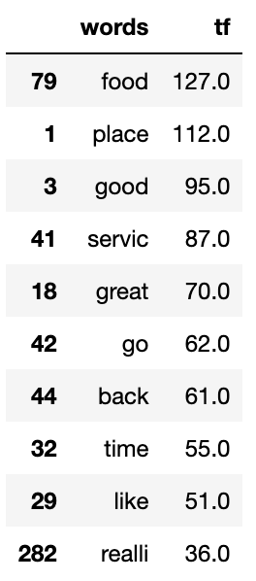
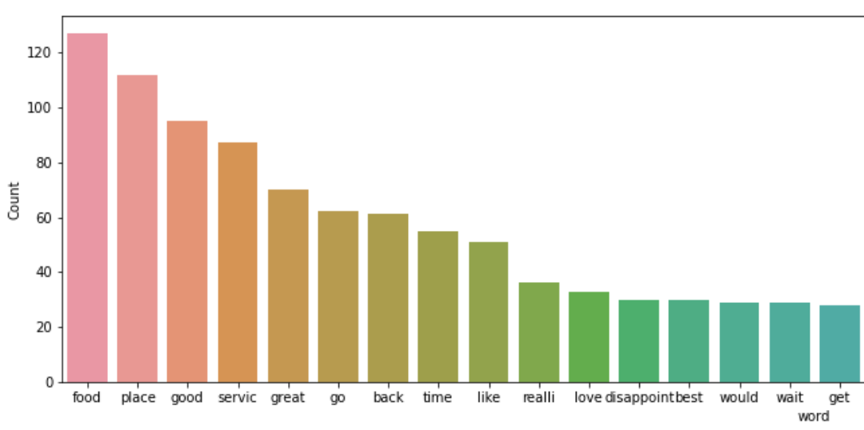
Top Words

Slide 11
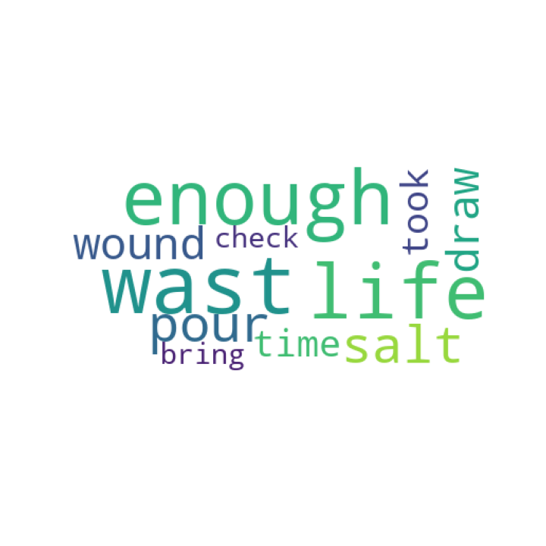
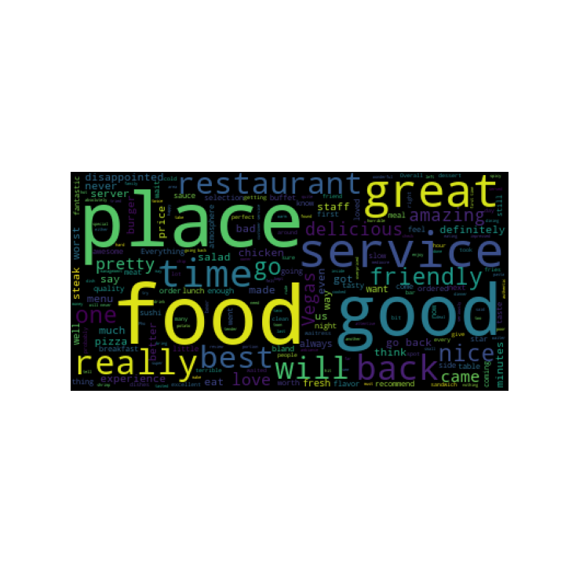
Wordcloud

Slide 12
Topic Results
Food Quality
Place Approval
01
02
Fidelity
Service
03
04

Slide 13
Sentiment Analysis
69%
31%
Positive
Negative
Positive reviews after processing the data
Negative reviews after processing the data

Slide 14
05
Future Work

Slide 15
Clustering
Your logo
K-means clustering to visually find groups which have not been explicitly labeled in the data.
Why:? To confirm business assumptions about what types of topics exist or to identify unknown new ones.

Slide 16
Thanks!
Do you have any questions?
hernantru943@gmail.com
GitHub
https://github.com/hernantru943/Restaurant-Customer-Reviews
Please keep this slide for attribution

